Slide 1
Coursera Data Science Capstone
Feature determination of Georgetown, Guyana

Slide 2
Introduction
X Investments inc. is a multinational investment firm headquartered in Y. They are constantly looking for new investment opportunities to amplify their portfolio and maximize shareholders gain. Word has reached the management team, of large scale oil discoveries in a maiden destination called Guyana. This potentially represents a lucrative market as the country is now preparing for first oil.
Taking under consideration that some executives and other company officials may need to travel to Guyana and that some may have to be there for a prolonged time, it is also necessary to gather information about features such as hospitals, restaurants, hotels, shopping districts and malls, schools, methods of transportation and other important aspects. This will help to determine if the setting is suitable for the officials and their families as required. All these aspects will help to identify the opportunities and opportunity costs and determine whether they are aligned to company goals.

Slide 3
Data
The application will perform a “lookup” of information on schools, universities, banks, police stations, hotels, restaurants, shopping malls, night clubs, markets and hospitals. These are some important features that will be of interest to executives who will make the trip to Guyana to determine the viability of the venture.

Slide 4
Methodology
To determine the location data of important features the foursquare API will be used in conjunction with jupyter notebooks. More specifically the Code will be placed in jupyter notebooks which will then access the foursquare database thru it API to obtain Geo-spatial data and perform a search of venues according the specified criteria within a 5000 meters radius of the Pegasus Hotel in Georgetown. The results will be plotted on a map to visualize the features which will allow for some contextual insight into the proximity of the different features from each other and how clustered there are.

Slide 5
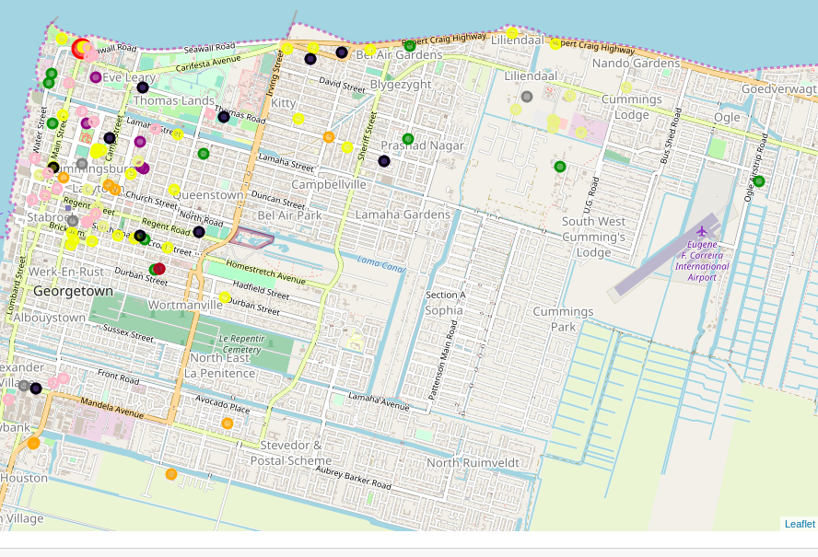
Results
Map showing the distribution of features around georgetown.

Slide 6
The color codes are:
Pegasus Hotel- red
Schools- orange
Restaurants- blue
Universities- green
Hotels- yellow
Police- brown
Shopping malls- khaki
Markets- grey
Night Clubs- black
Banks- pink

Slide 7
The results shows that there is a higher concentration of all the features within the boundaries of Hadfield street to the south, Vlisengen road to the east, Lamaha to the north and water street to the west. There are a few outliers scattered around various locations such as a few hotel along the Rupert Craig highway. The search parameter for police stations had to be changed from “police station” to “police” because it was returning results that weren’t exactly police entities.

Slide 8
Discussion and Recommendations
Search parameters need to be carefully considered and may require optimization to obtain the correct results as desired. Other criteria need to be considered such as the ratings of hotels, the types of restaurants such as Chinese food which is one of the famous cuisine that can be obtained in Guyana. Also, the research need to be extended to show results for other analysis such as economic and terrain specific information and culture data.

Slide 9
Conclusion
Based on the results obtained Georgetown has the required amenities for executives upon their visit and for a prolonged stay for those who may be required to stay for extended periods. The Pegasus hotel has a bank within very close proximity along with the other highlighted features and it is considered one of the more popular hotel in the country.

